Slide 1

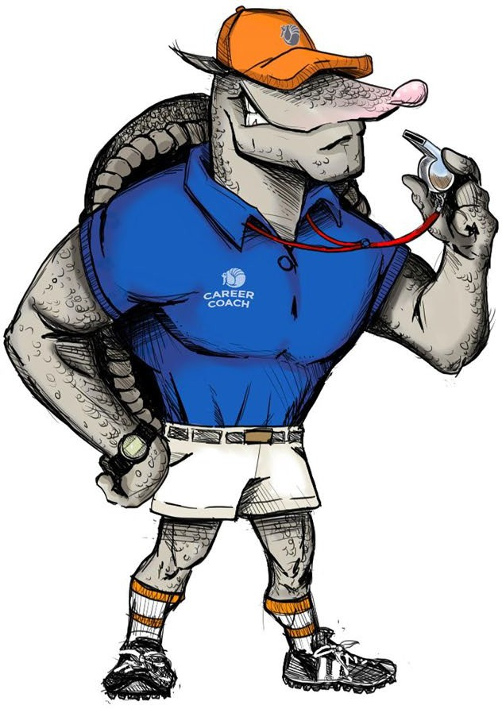

Slide 2



AGENDA
Resume & interview tips
Resume Workshop

Slide 3

WHAT IS A RESUME?
A resume is about knowing who you are and naming it for the employer
A resume is a working document that provides a targeted,concise snapshot of why your work skills and abilities will meet the employer’s needs
A marketing tool for you to the employer so that you can get the interview
Preparation tool/study guide for your interview
89% OF HIRING MANAGERS WILL NOT CONSIDER CANDIDATES WHO DO NOT HAVE A RESUME

Slide 4

RESUME CONTENT
Include:
Personal information
Objective
Work experience
Education
Volunteer work
Military service
Licenses & Certifications

Slide 5
RESUME STYLES
Two main styles used are:
Chronological
Solid, consistent work history
Seeking position in your current field
Combination
Applicants re-entering the work force
Students, new graduates, entry-level

Slide 6
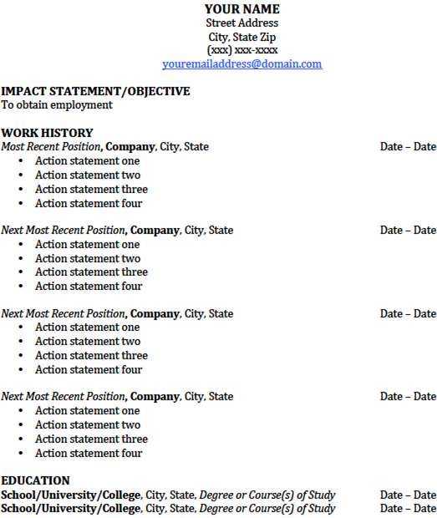
RESUME STYLES
Chronological
Contact Information
Objective Statement
Work History
Action Statements
Any formal education
Certifications, Licenses and Proficiencies

Slide 7
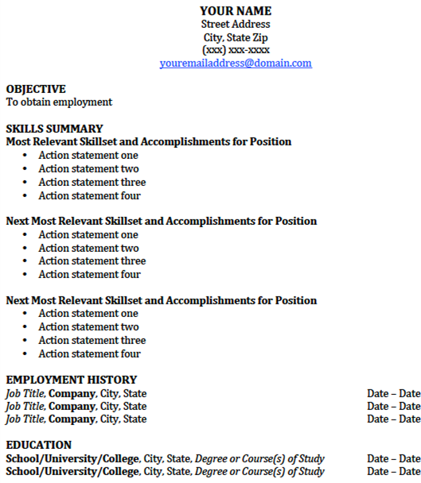
RESUME STYLES
Combination
Contact Information
Objective Statement
List of Relevant Skills
Action Statements
Chronological Employment History
Education
Certifications, Licenses and Proficiencies

Slide 8

RESUME WRITING: OBJECTIVE STATEMENT
Name what you want
Provide proof you can do the job
Identify your value to the company
Examples:
  Certified Nursing Assistant utilizing three years experience in hospitals and five years in customer service to serve patients well and help efficiently coordinate patient-doctor needs
To obtain a position in the hospitality industry using my four years experience in the restaurant to contribute to the successful reputation of the company and great customer satisfaction

Slide 9
RESUME WRITING: EMPLOYMENT SKILLS
Focus on hard skills over soft skills
Hard Skills: typing speed, certifications, multilingual
    Soft Skills: time management, teamwork, communication
Use Action Verbs
Use correct verb tense (present for current position, past for previous positions)
Do not use the same action verb twice within a particular job
List a minimum of three to four action statements to describe each job
Focus on skills and experiences that relate to the job for which you are applying
INTERVIEWERS SPEND ON AVERAGE BETWEEN 6-30 SECONDS READING YOUR RESUME

Slide 10
RESUME WRITING: ACTION STATEMENTS
Action Statement Examples
Weaker Statements
Stronger Statements
Shipped boxes
Packaged and shipped 30 packages daily via UPS and FedEx resulting in...
Processed customer transactions of cash, debit, and credit ensuring...
  Staffed and managed 25 person department that…
Rang up customers
Managed department

Slide 11


RESUME WRITING: EDUCATION & CERTIFICATIONS
Education:
List school, location, degree
Avoid dates if older than 10-15 years
Start with most recent education and work backwards
Certifications, Licenses, and Proficiencies:
Proficiency with MS Office
CNA I
CPR
Fluent in Spanish
ServSafe Certified
Others?

Slide 12
RESUME TIPS & TO-DO’S
Use professional emails
Only use quantifiable results
Avoid clichés or soft skills
Tailor your resume to each job
Include keywords and company/job language
Focus on the employer
Omit references
Keep it simple (don’t be cute or fancy)

Slide 13


RESUME REVIEW
How to use the resume to get the job
Recraft resume for this employer
Seek job openings
Review the job Learn about the
company
Collect data
Write rough draft
resume

Slide 14
INTERVIEWING

Slide 15
BEFORE THE INTERVIEW
Research Company (e.g., products/services, mission & value statements)
Plan your trip (know where you’re going, where to park, etc.) & arrive 10-15 minutes early
Practice interview questions
Get a good night’s sleep and don’t forget to eat before your appointment
Bring copies of your resume, a list of references, and a pen and pad for notes
Turn off your cell phone and/or smartwatch
Be prepared for either an individual or a panel interview (panel interviews allow more input on hiring decisions)
Adapted from information from thebalance.com: https://www.thebalance.com/how-to-prepare-for-a-job-interview-2061361
And careerchoiceguide.com: http://www.careerchoiceguide.com/preparing-for-a-job-interview.html#.WcU01LpFyUk

Slide 16
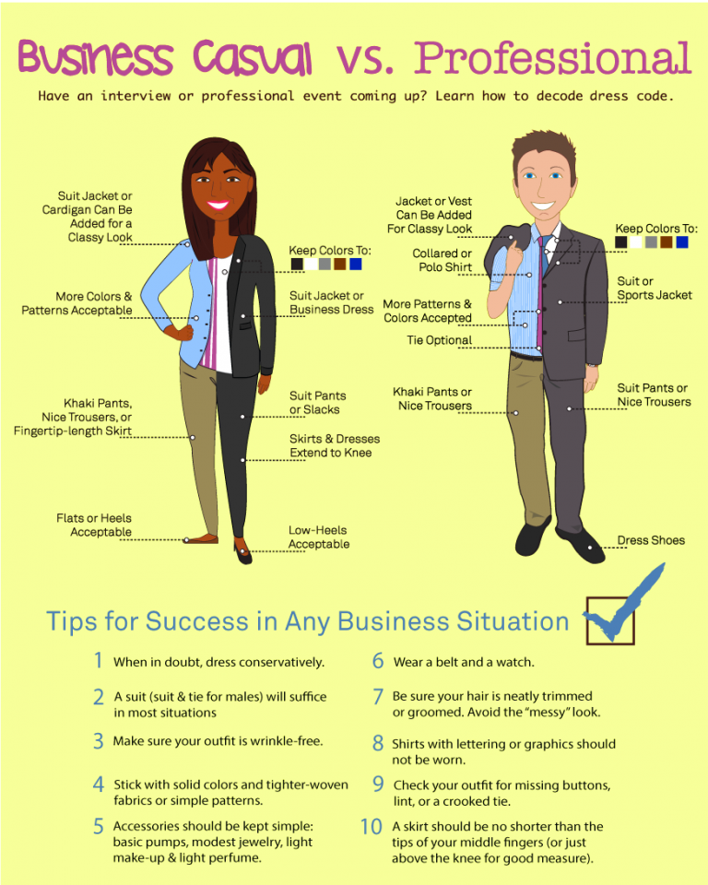
INTERVIEW DRESS TIPS
Dress code will vary depending on industry and employer
  It is okay to ask recruiters or hiring managers which type of dress is expected from interviewees
RCC’s Career Closet has free business professional and business casual clothing items available to students
Image source: https://business.ecu.edu/careers/first-impressions/

Slide 17
DURING THE INTERVIEW
Listen carefully (make eye contact with everybody)
Show interest and enthusiasm (lean forward, don’t fidget)
Give examples of your skills
Keep answers positive
Avoid rambling
Sit up straight with hands in lap (this also helps if you tend to fidget or talk with your hands)
Maintain a positive, engaged expression
Adapted from information from gcflearnfree.org: https://www.gcflearnfree.org/interviewingskills/what-to-do-during-an-interview/1/
And Investopedia.com: http://www.investopedia.com/financial-edge/0410/7-things-you-should-say-in-an-interview.aspx

Slide 18
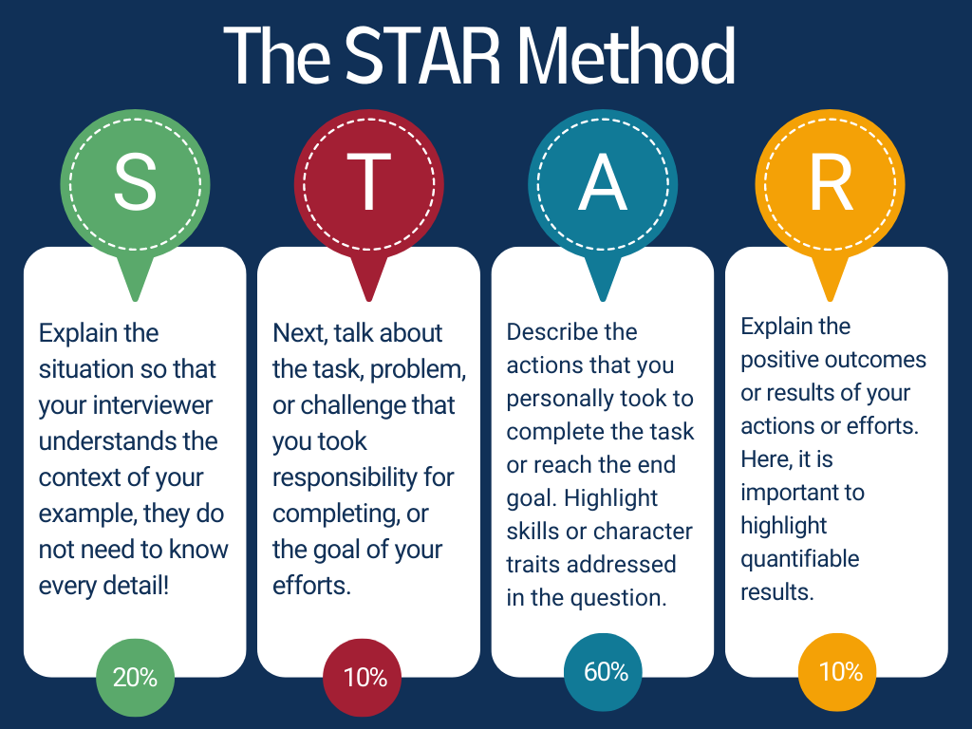
INTERVIEW QUESTIONS
Typical Questions:
Tell me about yourself
  Include general information about yourself, education, and work history
What are your strengths?
  Share positive and professional attributes
What are your weaknesses?
  Share how you are working to improve weaknesses
Why do you want to work here?
  Focus on the reason why you feel you would be a great fit for the position and/or company
  Avoid saying “I need a job”, “the pay is great”.
Where do you see yourself in five years?
  Keep your response professional
Behavioral Questions:
What would you do if…?
Tell me about a time when…
How do you handle stress?
Tell me about a problem you solved
Give an example of how you worked on a team.
How would you respond to this situation?
Adapted from information from glassdoor.com: https://www.glassdoor.com/blog/common-interview-questions/
Adapted from information from timesunion.com: http://blog.timesunion.com/careers/50-behavioral-based-interview-questions-you-might-be-asked/1538/
Image Source: https://capd.mit.edu/resources/the-star-method-for-behavioral-interviews/

Slide 19
AFTER THE INTERVIEW
Ask at least 2-3 questions to your interviewer
  How long has the job been vacant?
  How will my performance be evaluated?
  How would you describe your organization’s culture?
Ask about next steps after the interview
Express interest in job
Thank the interviewer(s) in person and send a thank you email or note
Avoid asking questions about pay and benefits. This is typically discussed once the job has been offered to you.

Slide 20
RCC CAREER SERVICES
We can help with career decision-making, writing resumes and cover letters, job search resources, and interview practice!
Visit https://www.randolph.edu/student-success/career-services.aspx or contact the Welcome Center to schedule an appointment!
Zip Lesane, Student Services Counselor: zslesane@randolph.edu and 336-633-0369

